Slide 1
Connectivity Analytics

Slide 2
Vertex Connectivity – In simpler terms
The connectivity (or vertex connectivity) of a connected graph G is the minimum number of vertices whose removal makes G disconnected or reduces to a trivial graph. It is denoted by K(G).
The graph is said to be k- connected or k-vertex connected when K(G) ≥ k. To remove a vertex we must also remove the edges incident to it.

Slide 3
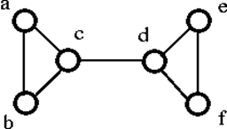
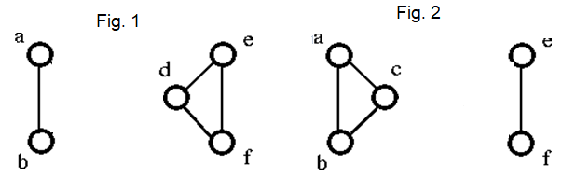
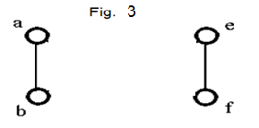
Example
Let's see an example:
The above graph G can be disconnected by removal of the single vertex either 'c' or ‘d’ (Fig.1 and Fig.2). Hence, its vertex connectivity is 1. Therefore, it is a 1-connected graph
The graph in Fig.3 is also disconnected, two vertices are removed here, however, the vertex connectivity is not 2. Because, vertex connectivity considers the minimum vertex removal which results in disconnected graph.
So, vertex connectivity is 1, for the given graph.

Slide 4
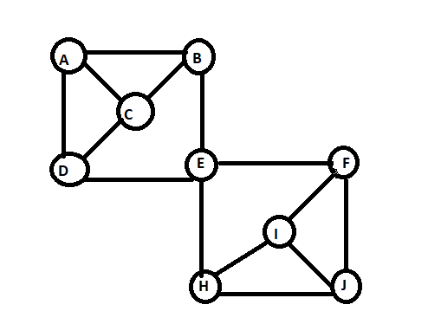
Vertex Connectivity
The vertex-connectivity of graph G, is the size of the smallest separating set of G.
A separating set is a set of vertices of G whose deletion from the graph makes the graph become disconnected.
It is denoted by κ(G).
κ(G) = 1
Separating Set = {E} , {E,F} , {E,H}, {E,H, I} etc

Slide 5
Edge Connectivity – In simpler terms
The edge connectivity of a connected graph G can also be defined as the minimum number of edges whose removal makes G disconnected. It is denoted by λ(G).
When λ(G) ≥ k, then graph G is said to be k-edge-connected.

Slide 6
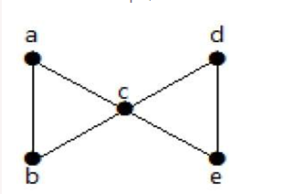
Example
Let's see an example,
From the above graph, by removing two minimum edges, the connected graph becomes disconnected graph. Hence, its edge connectivity is 2. Therefore the above graph is a 2-edge-connected graph.

Slide 7
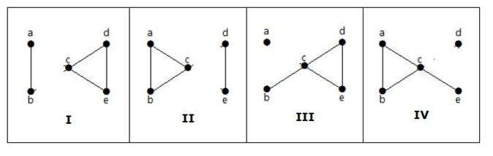
Example – Continued…
Here are the following four ways to disconnect the graph by removing two edges:
Note: Graph will get disconnected even if three edges are removed, but the minimum number of edges required is 2, (i.e.)the edge connectivity

Slide 8
Edge Connectivity
Edge-connectivity of graph G is the size of the smallest disconnected set of G. It is denoted by λ(G).
A disconnected set is a set of edges of G whose deletion from the graph makes the graph become disconnected.
λ(G) = 2
Disconnected Set = {E-F,E-H} ; {E-F, E-H, E-B, E-D}

Slide 9
Minimum degree
δ(G) is the minimum degree of G (i.e. the degree of the vertex of G with the minimum degree).
δ(G) = 3

Slide 10

Relationship between Vertex Connectivity, Edge Connectivity and Minimum degree
Where κ(G) denotes vertex connectivity,
λ(G) denotes edge connectivity and
δ(G) denotes minimum degree.

Slide 11
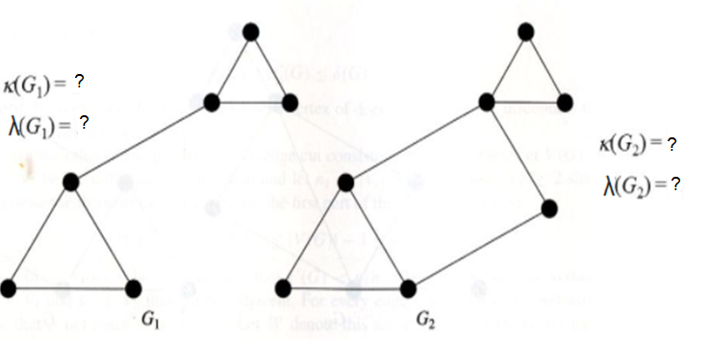
Find the vertex connectivity and edge connectivity.

Slide 12
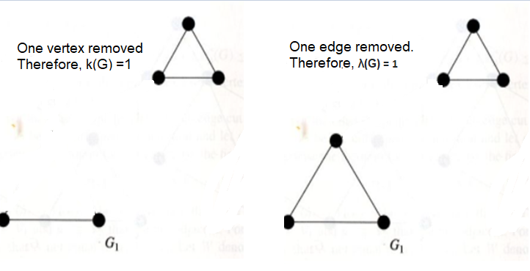
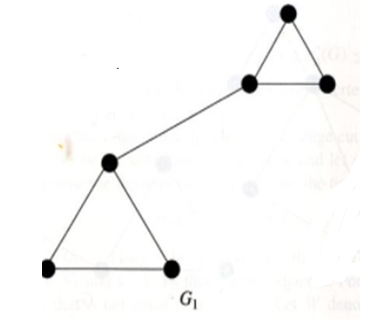
Find the vertex connectivity and edge connectivity.
For Graph G1, the vertex connectivity and edge connectivity is 1.

Slide 13
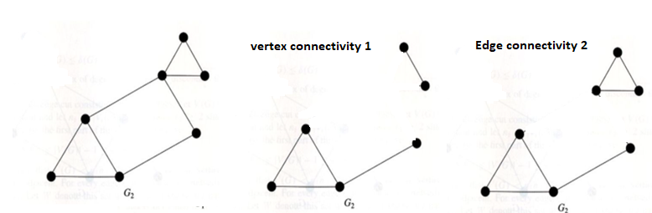
Find the vertex connectivity and edge connectivity.
For Graph G2, the vertex connectivity is 1 and edge connectivity is 2.

Slide 14
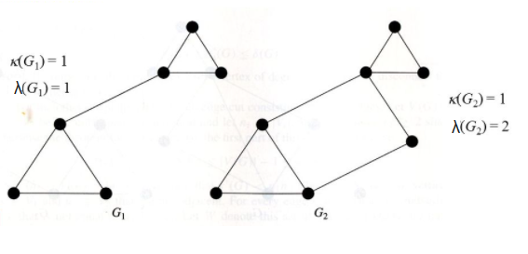
Find the vertex connectivity and edge connectivity.

Slide 15
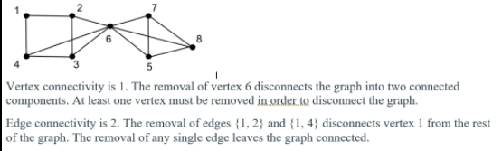
Example

Slide 16
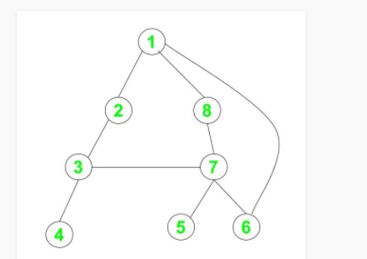
Example
Find the vertex connectivity and edge connectivity of the below graph.
κ(G) = 1
λ(G) = 1
Separating set = {3},{3,4},{6,7}
Disconnected set = {3-4},{1-6,7-6},{1-6,8-7}

Slide 17
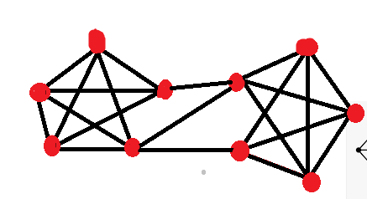
Exercise – Find the edge connectivity and vertex connectivity

Slide 18
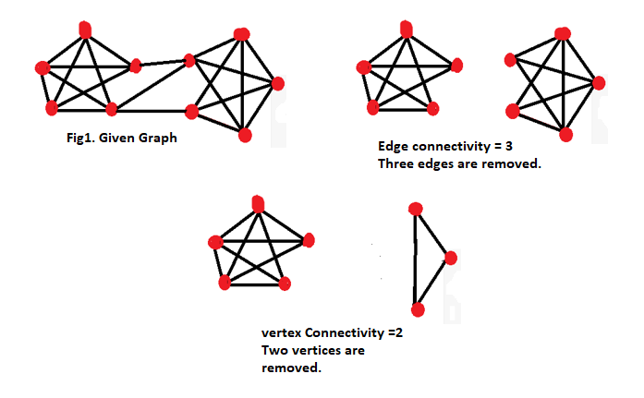
Find the edge connectivity and vertex connectivity

Slide 19
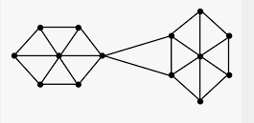
Try your hands : Find edge connectivity and vertex connectivity

Slide 20
Try your hands - Answer
Vertex connectivity is 1
Edge connectivity is 2

Slide 21
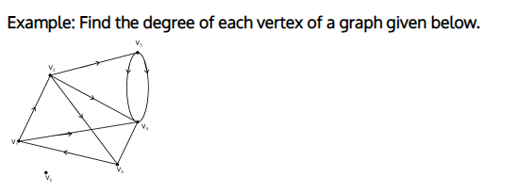
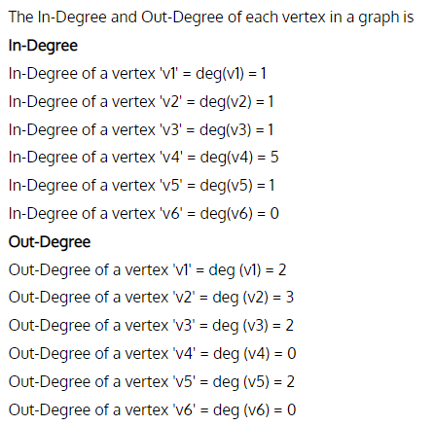
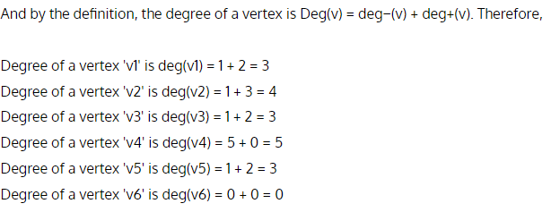
Indegree – Outdegree of graph
A node's in-degree is the number of of incoming edges and out-degree is the number of outgoing edges from the node.

Slide 22
Similarity of graphs using degree of nodes
Step 1:
Find the degree of each node in a graph.
Step 2:
Create a histogram for the nodes which have a certain degree.

Slide 23
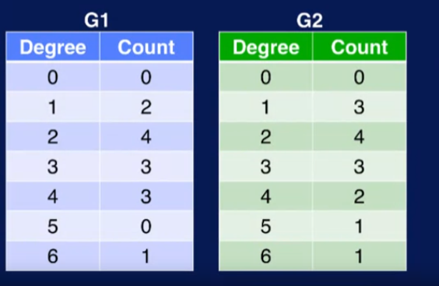
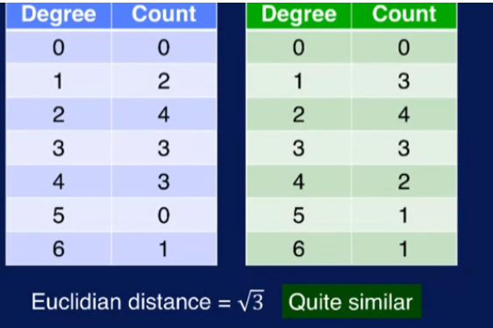

Example:

Slide 24
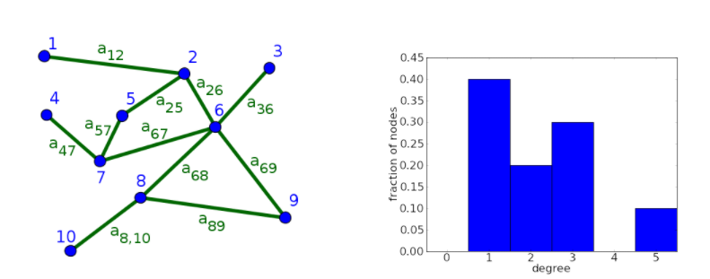
Degree Histogram of undirected graph
For this undirected graph, the degrees are k1=1, k2=3, k3=1, k4=1, k5=2, k6=5, k7=3, k8=3, k9=2, and k10=1. Its degree distribution is Pdeg(1)=2/5, Pdeg(2)=1/5, Pdeg(3)=3/10, Pdeg(5)=1/10, and all other Pdeg(k)=0.

Slide 25
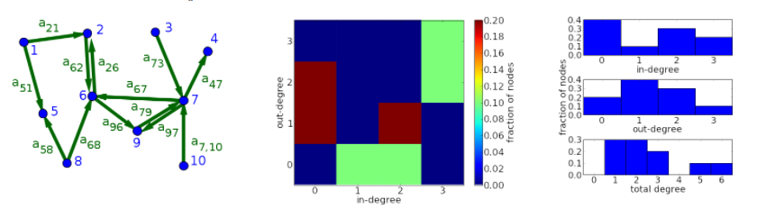
Degree Histogram of directed graph

Slide 26
Degree Histogram of directed graph
For the directed graph, the in- and out-degrees are (kin1,kout1)=(0,2), (kin2,kout2)=(2,1), (kin3,kout3)=(0,1), (kin4,kout4)=(1,0), (kin5,kout5)=(2,0), (kin6,kout6)=(3,2), (kin7,kout7)=(3,3), (kin8,kout8)=(0,2), (kin9,kout9)=(2,1), and (kin10,kout10)=(0,1). The total degrees ktot1=2, ktot2=3, ktot3=1, ktot4=1, ktot5=2, ktot6=5, ktot7=6, ktot8=2, ktot9=3, and ktot10=1.

Slide 27
Types of nodes
Listener nodes (greater in-degree than out-degree)
Talker nodes (greater out-degree than in-degree)
Communicator nodes (high in-degree and high out-degree)

Slide 28
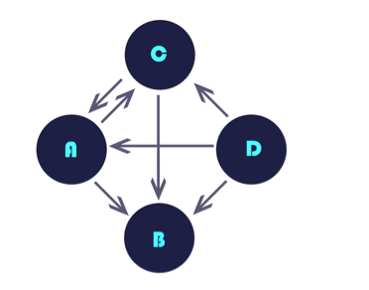
Example
Find the greatest Communicator, listener and talker in the below graph
B is greatest listener (in-degree is 3)
D is greatest talker (Out-degree is 3)
C is greatest communicator(in-degree =2,Out-degree = 2)

